Slide 1

Activation Template
1
2
3
Concepts
Why did we make it this way?
Structures and Code
What is it?
IDE / Debugging
How do we use it?

Slide 2
Concepts
Automatic
Reuseable
Flexible
Automatic
Reuseable
Flexible

Slide 3
Concepts
Reuseable
Flexible
Automatic
Self configuring database schema on install
Automatic loading
Automation of manual task using Tools

Slide 4
Concepts
Flexible
Automatic
Reuseable
Prebuilt features
Structures that transfer easily

Slide 5
Concepts
Automatic
Reuseable
Flexible
No hidden packages or functionality
Many activation technologies supported out of the box

Slide 6
Structure
/features
/tool
/database
/features - Prebuilt features to drop into the project.
/tool - Useful tools for the activation. Use with `npm run tool`
/database - Migrations and Seeds. Also hold sqlite's db file.
/src - Contains the application code. These are the core elements

Slide 7
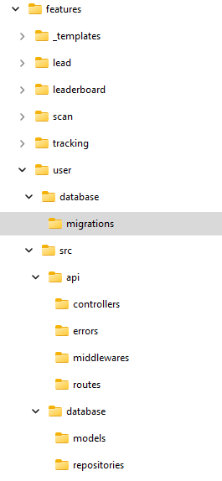
Structure
/tool
/database
/features
_templates
user
leaderboard
scan
lead
tracking
npm run new

Slide 8
Structure
/database
/features
/tool
npm run tool
new
install
api-error-list
serialport-list
create-template-folders
1 module.exports = async () => {
2 // Do thing when tool is ran
3 };

Slide 9
Structure
/features
/tool
/database
1 const { Sequelize, DataTypes } = require('sequelize');
2 const timestampConfig = require('../timestamp.configs');
3
4 const tableName = '{{CHANGE_ME}}';
5 const dto = {
6 id: {
7 type: DataTypes.UUID,
8 primaryKey: true,
9 defaultValue: Sequelize.UUIDV4,
10 },
11 name: {
12 type: DataTypes.STRING,
13 allowNull: false,
14 },
15 ...timestampConfig.fields,
16 };
17
18 module.exports = {
19 up: async (queryInterface) => {
20 await queryInterface.createTable(tableName, dto);
21 },
22 down: async (queryInterface) => {
23 await queryInterface.dropTable(tableName);
24 },
25 };
sqlite.db
migrations
seeders

Slide 10
/src
/database
/api
/socket
/database - Seqeuelize
/api - Express api
/socket - Socket.IO
/util - Utility functions and libs
/light - Dmx lighting
/robot - Johnny-Five

Slide 11
/src
/api
/socket
/database
1 const { models, thens } = require('..');
2
3 const { {{CHANGE_ME}} } = models;
4 const { One, All, Update, Destroy } = thens;
5
6 const create = async ({ name }) => {{CHANGE_ME}}.create({ name }).then(One);
7
8 const all = async ({ limit, offset }) =>
9 {{CHANGE_ME}}.findAll({ limit, offset, order: [['createdAt', 'ASC']] }).then(All);
10
11 const one = ({ id }) => {{CHANGE_ME}}.findOne({ where: { id } }).then(One);
12
13 const destroy = ({ id }) => {{CHANGE_ME}}.destroy({ where: { id } }).then(Destroy);
14
15 const update = ({ id, name }) => {{CHANGE_ME}}.update({ name }, { where: { id } }).then(Update);
16
17 module.exports = {
18 create,
19 destroy,
20 all,
21 one,
22 update,
23 };
models
repos
1 module.exports.thens = {
2 All: (l) => l?.map((r) => r?.get({ plain: true }) || r) || l,
3 One: (r) => r?.get({ plain: true }) || r,
4 Update: (d) => Boolean(parseInt(d, 10)),
5 Destroy: Boolean,
6 };

Slide 12
/src
/database
/socket
/api
1 const express = require('express');
2 const router = express.Router();
3 const middlewares = require('../middlewares');
4 const { {{CHANGE_ME}} } = require('../controllers');
5 const { joi, validate } = middlewares.validator;
6
7 router.get(
8 '/',
9 validate({
10 query: {
11 limit: joi.number().integer().min(1).default(10),
12 offset: joi.number().integer().min(0).default(0),
13 },
14 }),
15 {{CHANGE_ME}}.get
16 );
routes
middlewares
controllers
errors
1 const { repositories } = require('../../database');
2 const { {{CHANGE_ME}} } = repositories;
3
4 module.exports.get = async (req, res) => {
5 const { limit, offset } = req.query;
6 res.json({ {{CHANGE_ME}}: await {{CHANGE_ME}}.all({ limit, offset }) });
7 };

Slide 13
/src
/api
/database
/socket
middlewares
controllers
1 const { repositories } = require('../../database');
2 const socket = require('../../socket');
3
4 const { {{CHANGE_ME}} } = repositories;
5
6 module.exports.create = async (client, data) => {
7 const { name } = data;
8 socket.emit('{{CHANGE_ME}}_created_item');
9 await {{CHANGE_ME}}.create({ name });
10 };

Slide 14
/src
/light
/util
/robot
1 const dgram = require('dgram');
2 const util = require('util');
3
4 module.exports.client = (host, port) => {
5 const client = dgram.createSocket('udp4');
6 const returnObj = { client };
7 const send = util.promisify(client.send).bind(client);
8 returnObj.send = async (message) => {
9 const messageBuffer = Buffer.from(message);
10 return send(messageBuffer, 0, messageBuffer.length, port, host);
11 };
12 return returnObj;
13 };
autoloaded objects
1 const util = require('../../util');
2 const client = util.udp.client(host, port);
3 client.send('hello');

Slide 15
/src
/util
/robot
/light
1 module.exports.driver = 'enttec-usb-dmx-pro';
2 module.exports.deviceId = 'COM';
3 module.exports.options = {};
4
5 module.exports.initialState = {1:255, 2:0, 3:0};
universes
scenes
1 const { universes } = require('..');
2
3 const universe = universes.{{CHANGE_ME}};
4
5 const animation = universe.animation();
6 animation.addChannel(1, [255, 255, 255], 500).addChannel(1, [0, 0, 0], 500);
7
8 module.exports.start = async () => {
9 animation.runLoop();
10 };
11
12 module.exports.stop = async () => {
13 animation.stop();
14 universes.updateChannel(1, [0, 0, 0]);
15 };
16 // Call with require('../../light').scenes.example.stop()

Slide 16
/src
/light
/util
/robot
boards
1 // /src/robot/boards/example.boards.js
2 const five = require('johnny-five');
3 let led;
4 module.exports.ready = async (board) => {
5 led = new five.Led({
6 board,
7 pin: 13,
8 });
9 };
10 module.exports.start = async() {
11 led.blink();
12 }
13 // Call with require('../../robot').example.start();

Slide 17
IDE / Debugging
.vscode
.env
Debugger
.env
.vscode
Debugger

Slide 18
IDE / Debugging
Debugger
.vscode
.env
LOG_LEVEL=debug,info,warn,error
DATABASE_DIALECT=mysql,sqlite
SQL_DATABASE=
INSTANCE_ID=
JWT_SECRET=

Slide 19
IDE / Debugging
.env
Debugger
.vscode
eslint
prettier
Launch config for debugger

Slide 20
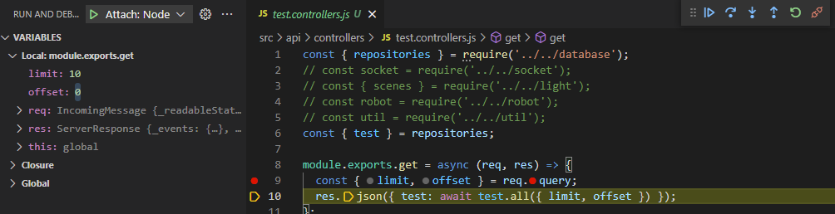
IDE / Debugging
.vscode
.env
Debugger
npm run local
F5 to attach
Use breakpoints to inspect part of the code

